Slide 1

Dr Sooriakumaran
Patient Participation Group
9th January 2026

Slide 2
Agenda
Online Booking Audit
Patient Satisfaction Survey
Projects
  Review 2025/26
  Looking forward 2026/27
PPG Development
  Virtual Views
  Increase membership
  Topics to engage on

Slide 3
Online bookings
If each call was 2mins long that’s approx 9 hours saved on the phone (or 1.5 hours per month)!

Slide 4
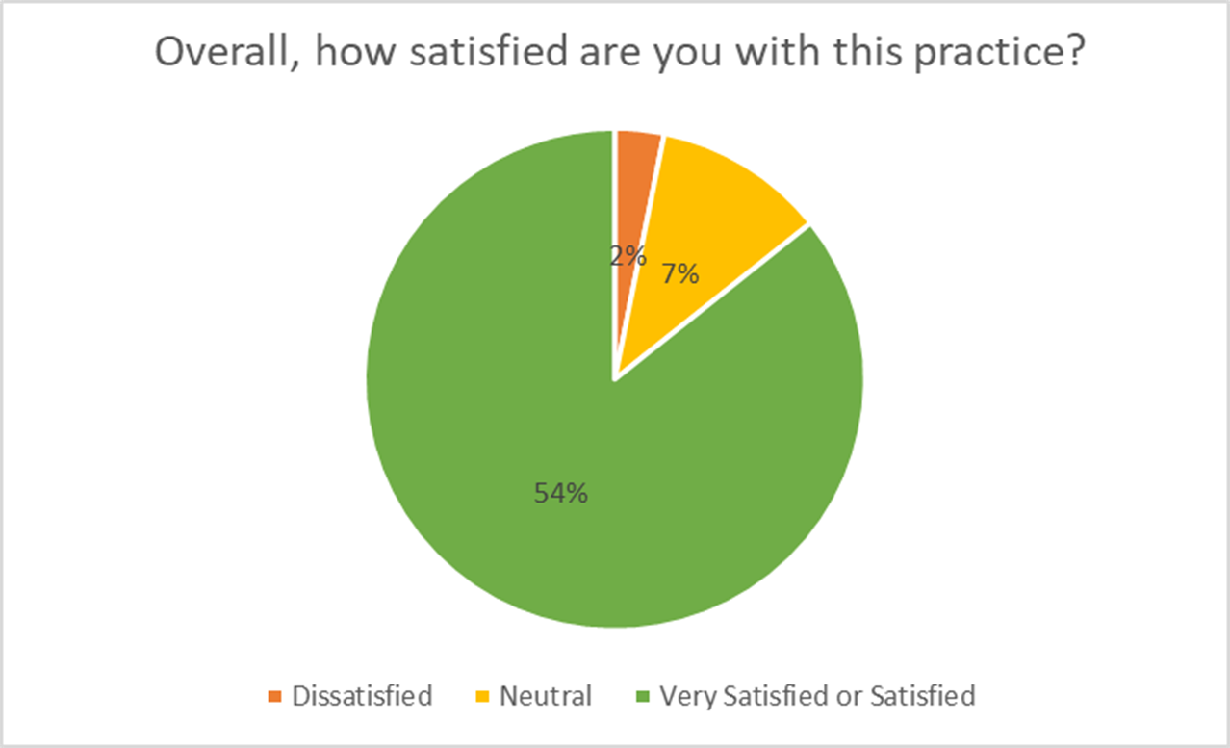
Patient Satisfaction Survey Jan 2025

Slide 5
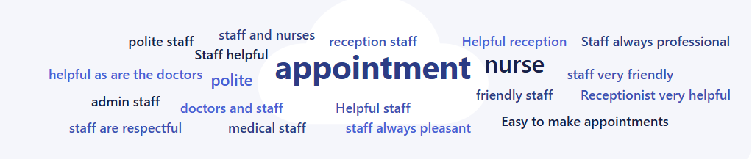
What do you like most about the practice?

Slide 6

Goals and objectives – 2025/6 - Review
Theme | Area of work to be examined | Signs of success
Safe Effective Well-led | QOF achievement | Improve QOF achievement
Caring Responsive Effective Well-led | Maximise use of improved telephony | Improved telephony experience for patients Increased data for management
Safe Caring Effective Responsive Well-led | New consulting room | Increased capacity, for clinic work and isolation Improved fire exit
Safe Responsive Well-led | Updated fire alarm system | New up-to-date fire alarm system installed at both sites

Slide 7
Goals and objectives – 2025/6 - Review
Theme | Area of work to be examined | Signs of success
Safe Responsive Well-led | Updated fire alarm system | New up-to-date fire alarm system installed at both sites
Safe Responsive Well-led | Fire doors | Fire regulation compliance (both sites)
Safe Responsive Well-led | Emergency Lighting | Fire regulation compliance (both sites)
Safe Responsive Well-led | Security System | Security compliance (both sites)

Slide 8
Goals and objectives – 2025/6 - Review
Theme | Area of work to be examined | Signs of success
Safe Caring Effective Responsive Well-led | Phlebotomy Service | Increase phlebotomy capacity to support high risk drug monitoring due to lack of capacity in Pathology First
Safe Caring Effective Responsive Well-led | Online consultation requests | Compliance with GP Contract

Slide 9
Goals and objectives – 2026/7 - Planned
Theme | Area of work to be examined | Signs of success
Safe Effective Well-led | QOF achievement | Improve QOF achievement
Safe Caring Effective Responsive Well-led | Total Triage | Consideration of total triage model for the practice
Safe Caring Effective Responsive Well-led | Patient Engagement | Improve patient engagement

Slide 10
Goals and objectives – 2026/7 - Planned
Theme | Area of work to be examined | Signs of success
Safe, Caring, Effective Responsive Well-led | Engage with Carers | Increased engagement with Carers
Effective Well-led | Administrative efficiencies | Improved administrative efficiency
Caring Effective Responsive | Bereaved families | Support for bereaved families of patients
Safe Caring Effective Responsive Well-led | Care Home | Encourage cohesive working between practice and Care Home for benefit of residents and Care Home Staff

Slide 11
PPG Development
Virtual Views
  Dr Sooriakumaran Medical Practice VPPG | MSE Virtual Views
Increase membership
Topics to engage on

